Slide 1

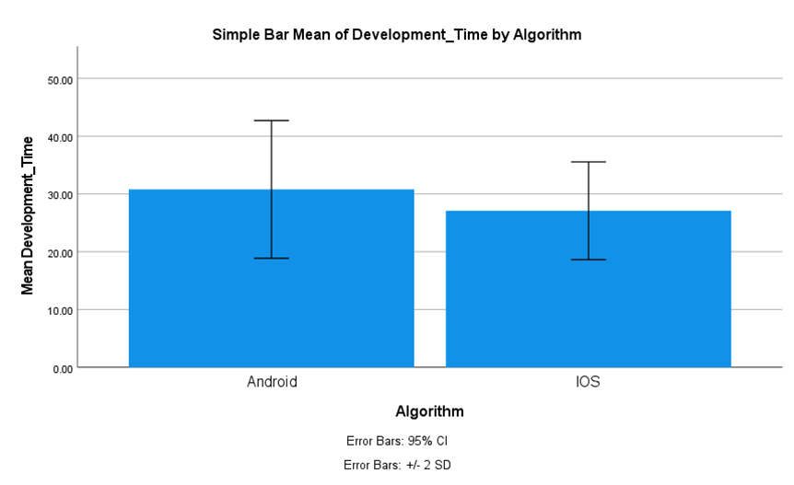
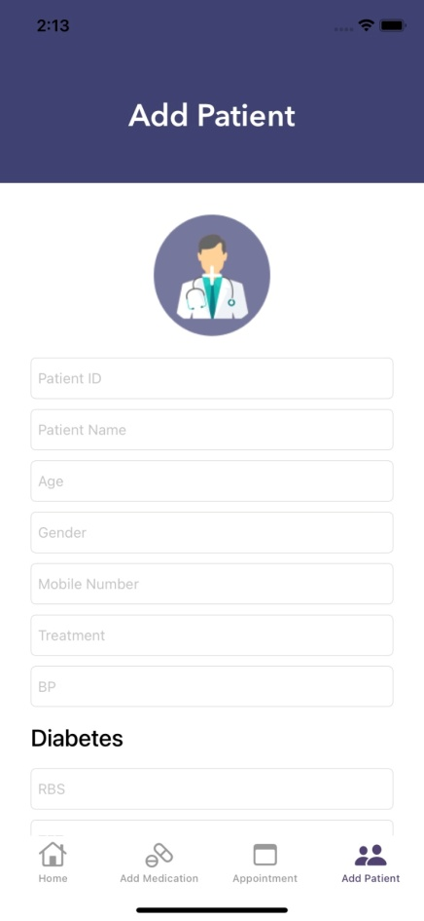
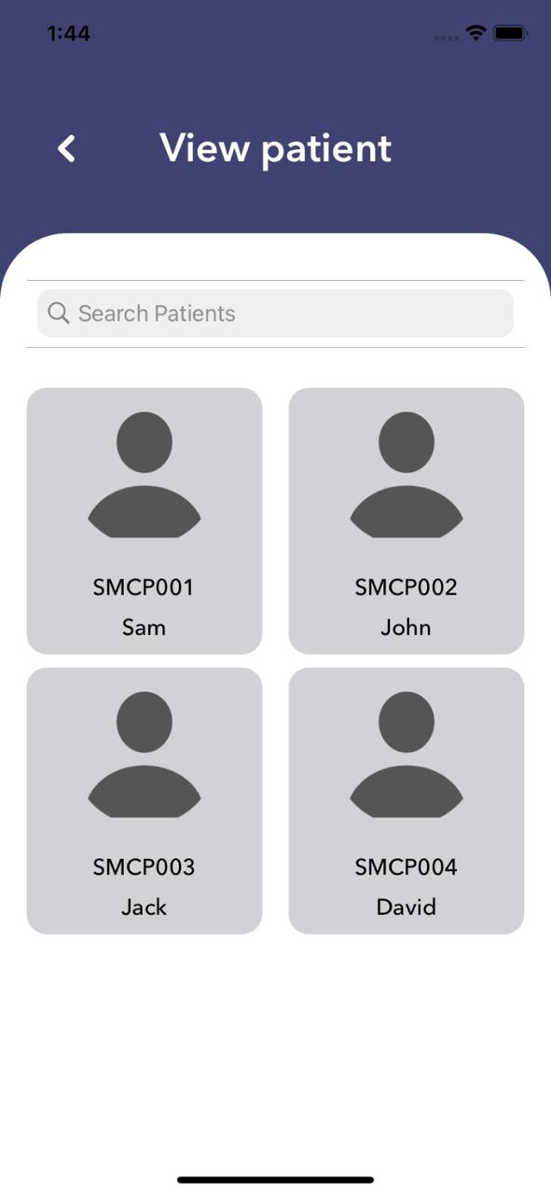
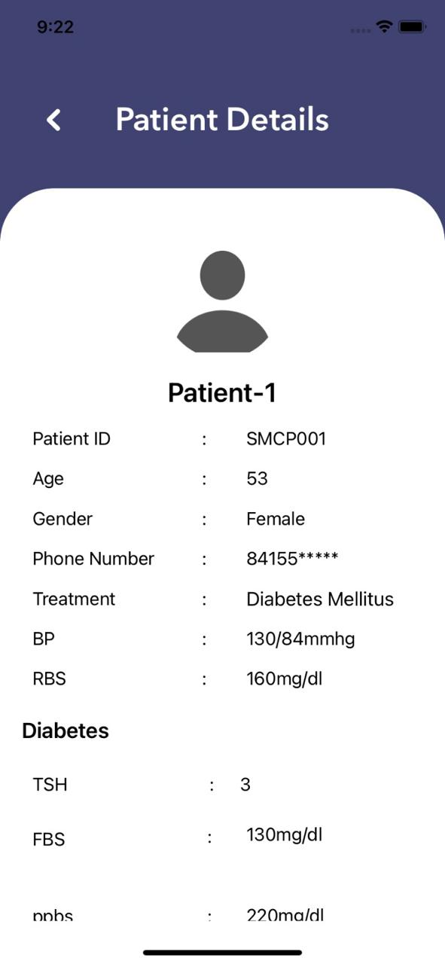
Name: Ms Nisha N Register Number: 192011495L
Guided by Dr T Suresh Balakrishnan
Ms. Poorani.S
Guided by Dr. Mary Valantina. G
Comparison Analysis of Development Time on Medication Reminder App for A Comparative Study Between Android Application and iOS Application
INTRODUCTION
App Development
The application helps patients and doctors communicate by providing a way for the patient to examine all medication and attendee details from the doctor's login in the Medication-Reminder application.
The goal of this project is to pinpoint areas in which iOS and Android perform differently in terms of development time, as well as areas that could use improvement.
Discover Medication-Reminder and transform the way you treat medication rehabilitation. Developers and users can assess how effectively contents are distributed on various platforms in their trip to touch patients by measuring the development time.
The project's ultimate goal is to enhance user experience and instructional efficacy across iOS and Android platforms by minimizing development time discrepancies.
Improving scalability and maintainability not only enhances the efficiency of the development process but also ensures that the Medication-reminder application remains adaptable to evolving user needs and technological advancements.
iOS Application
Android Application
Fig 1:Medication-Reminder
MATERIALS AND METHODS
Retrieve User Data from the Database
Android Application
Android Application Process
Database – XAMPP(MySQL)
PHP- Visual Studio code.
Testing- Postman
Output- Android Studio
Creating URL for backend connection with database
Choose Application
Strategy
Analysis & Planning.
UI/UX Design.
App Development.
Testing.
Deployment & Support.
Develop and Test the Data
Calculating Development time
Data Collection Processing and measuring the data of sample size of N = 10, N = 10 Total = 20
iOS Application Process
Database – XAMPP(MySQL)
PHP- Visual Studio code.
Testing- Postman
Output- Swift Xcode
User inputs (GET/POST) for Structure Model &
backend connection
iOS Application
Compare the user data
RESULTS
Group Statistics
 | Algorithm | N | Mean | Std. Deviation | Std. Error Mean
Development Time | Android | 10 | 30.80000 | 5.95910 | 1.88444
 | iOS | 10 | 27.10000 | 4.22821 | 1.33708
Comparision of Andriod and iOS Application in terms of Development Time.
The Mean Recovery Rate of iOS is significantly higher than Android in Medication-Reminder.
The choice of development framework, such as Swift for iOS and Android Studio for Android, can significantly influence development time and productivity.
Fig 2: Comparision of Andriod and iOS Application in terms of Development Time.
Fig 3:Add patient
Fig 4:Patient List
Fig 5:Patient Details
DISCUSSION AND CONCLUSION
Based on T-test Statistical analysis, the significance value of p=0.002 (independent sample T - test p<0.05) is obtained and shows that there is a statistical significant difference between the group 1 and group 2.
Overall, the Response time of the Medication-Reminder iOS Application is 26.30ms and it is better than the Android Application.
Medication-Reminder Android Application is 33.23ms
The research results clearly show that, when it comes to the Medication-Reminder development time efficiency, the iOS application performs better than the Android application.
The more efficient development time of the iOS application may allow for quicker implementation of new features, updates and bug fixes. This agility in development can contribute to a more dynamic and responsive user experience on the iOS platforms, further reinforcing user satisfaction and loyalty.
BIBLIOGRAPHY
Kim, Ben Y. B., Anis Sharafoddini, Nam Tran, Emily Y. Wen, and Joon Lee. 2018. “Consumer Mobile Apps for Potential Drug-Drug Interaction Check: Systematic Review and Content Analysis Using the Mobile App Rating Scale (MARS).” JMIR mHealth and uHealth 6 (3): e8613.
Santo, Karla, Sarah S. Richtering, John Chalmers, Aravinda Thiagalingam, Clara K. Chow, and Julie Redfern. 2016. “Mobile Phone Apps to Improve Medication Adherence: A Systematic Stepwise Process to Identify High-Quality Apps.” JMIR mHealth and uHealth 4 (4): e6742.
Bartlett Ellis, Rebecca J., James H. Hill, K. Denise Kerley, Arjun Sinha, Aaron Ganci, and Cynthia L. Russell. 2019. “The Feasibility of a Using a Smart Button Mobile Health System to Self-Track Medication Adherence and Deliver Tailored Short Message Service Text Message Feedback.” JMIR Formative Research 3 (2): e13558.
Park, Jamie Yea Eun, Jenny Li, Alyssa Howren, Nicole Wen Tsao, and Mary De Vera. 2019. “Mobile Phone Apps Targeting Medication Adherence: Quality Assessment and Content Analysis of User Reviews.” JMIR mHealth and uHealth 7 (1): e11919.

